Slide 1

Accelerating N-Body Simulations with CUDA
A 7-Step Optimization Journey
Term Project Presentation

Slide 2

Project Objectives
Implement Parallel Solution
Establish Baseline
Demonstrate Performance
Develop optimized sequential CPU solution for comparison
Prove significant speedup through parallel efficiency techniques
Process large-scale dataset using CUDA on GPU hardware

Slide 3

The N-Body Simulation Problem
The N-Body simulation is a foundational physics problem where gravitational forces between N particles must be computed. Each particle's trajectory is determined by interactions with all other particles, creating O(N²) computational complexity. For 8,192 particles, this means 67 million force calculations per timestep.
Newton's Law of Universal Gravitation

Slide 4

The Dataset: Star Cluster Simulation
Data Source
Data Structure
Publicly available CSV files from star cluster simulation archives, containing millions of simulated particle records.
Each particle contains: position (x, y, z), velocity (vx, vy, vz), and mass. Scales from 2,048 to 65,536 particles.

Slide 5
Approach 0: Sequential Baseline
The "best possible" direct solution, implemented in optimized C++. Computes every particle-particle interaction accurately with zero approximations. Its O(N²) behavior makes it the perfect reference for measuring GPU speedup and validating correctness.
void calculateForces(std::vector<Particle>& particles, int N) { for (int i = 0; i < N; ++i) { float fx = 0.0f, fy = 0.0f, fz = 0.0f; for (int j = 0; j < N; ++j) { if (i == j) continue; // Calculate gravitational force and accumulate fx += force_scalar * dx; } }}

Slide 6
Seven Optimization Approaches
Rather than implementing a single parallel solution, we iteratively constructed seven versions—each applying a distinct parallel efficiency technique. This journey reveals how careful optimization transforms a naive port into a highly-tuned multi-GPU accelerator.
Step 1: Naive Port
Direct kernel translation
Step 2: Coalescing
Memory layout optimization
Step 3: Shared Memory
On-chip caching strategy
Step 4: Instruction Tuning
Hardware utilization
Step 5: Async Streams
Concurrency management
Step 6: Warp Primitives
Advanced GPU patterns
Step 7: Multi-GPU
Scaling across devices

Slide 7
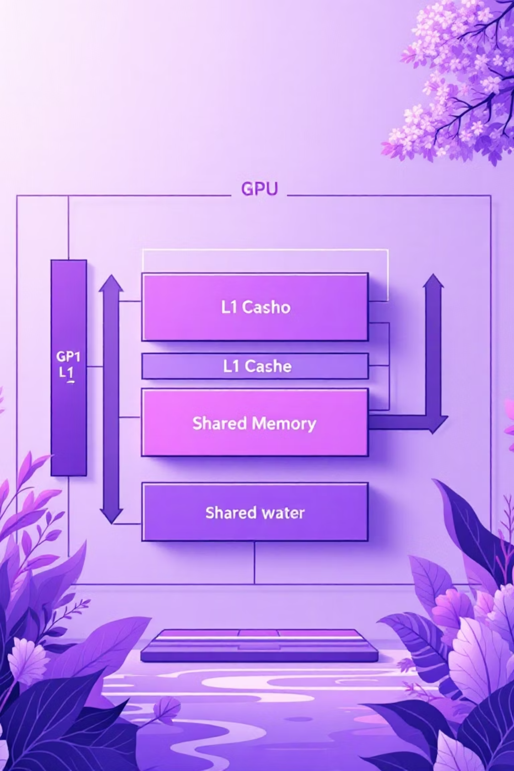
Optimization Progress: Early Techniques
Naive Kernel Port
1
Moving C++ loops into CUDA kernels directly. Each thread reads all N particles from global memory—extremely inefficient with massive bandwidth bottlenecks.
Memory Coalescing
2
Restructuring data from Array-of-Structures (AoS) to Structure-of-Arrays (SoA) using float4 vectors. Adjacent threads now access consecutive memory, enabling hardware coalescing for 4× bandwidth improvement.
Shared Memory Tiling
3
The breakthrough optimization. Loading particle tiles into fast on-chip __shared__ memory. Reduces global memory traffic from O(N²) to O(N), dramatically accelerating force calculations through massive data reuse.

Slide 8

Optimization Progress: Advanced Techniques
Instruction Tuning
1
Used fused multiply-add (fmaf), fast inverse square root (rsqrtf), and cudaOccupancyMaxPotentialBlockSize for optimal hardware utilization and register efficiency.
Asynchronous Streams
2
Employed CUDA Streams with pinned memory (cudaHostRegister) and cudaMemcpyAsync to overlap data transfers with kernel execution across multiple asynchronous pipelines.
Warp Primitives & Multi-GPU
3
Implemented warp-level reductions using __shfl_down_sync, atomic operations for verification, and domain decomposition with cudaMemcpyPeerAsync for multi-GPU scaling.

Slide 9
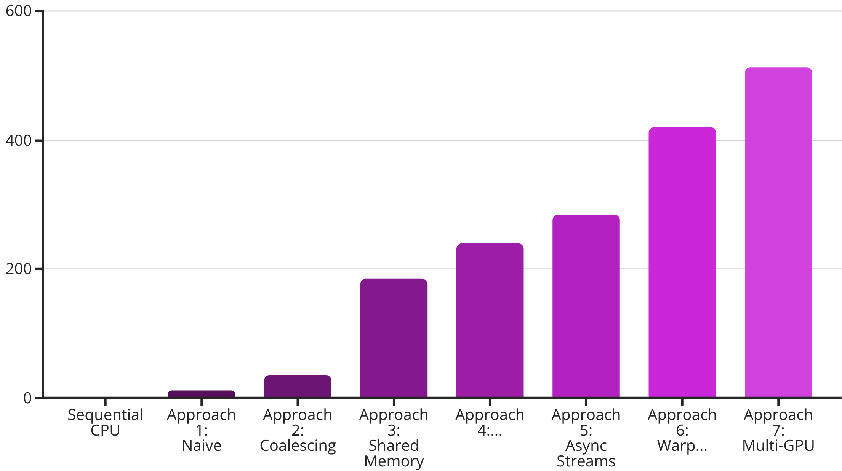
Results: Speedup Across Optimizations
This benchmark demonstrates the cumulative impact of each optimization technique. The sequential baseline explodes exponentially, while each successive GPU approach shows dramatic improvement. The final multi-GPU implementation achieves over 500× speedup.
Each optimization builds upon previous work, showing that GPU acceleration requires understanding memory hierarchies, hardware utilization, and advanced parallel patterns—not merely porting code.

